Slide 1
Revised universal soil loss equation
Goal for today:
Be able to calibrate all model parameters in RUSLE and calculate erosion rates
Interpret erosion rate maps and relate hotspots to geology/tectonics and human actions
Compare modelled erosion rates with measured river sediment export rates
Interpret differences between erosion and export in terms of sediment connectivity

Slide 2
Revised universal soil loss equation
Goal for today:
Be able to calibrate all model parameters in RUSLE and calculate erosion rates
Interpret erosion rate maps and relate hotspots to geology/tectonics and human actions
Compare modelled erosion rates with measured river sediment export rates
Interpret differences between erosion and export in terms of sediment connectivity
River profiles and what they tell us
Goal for today:
Describe how rivers respond to changes in tectonics and bedrock geology

Slide 3
RUSLE
Standard tool for estimating soil erosion in government agencies, private companies, etc.
Very useful tool to know
All models are wrong, some are useful:
Comes with caveats that we should assess…

Slide 4
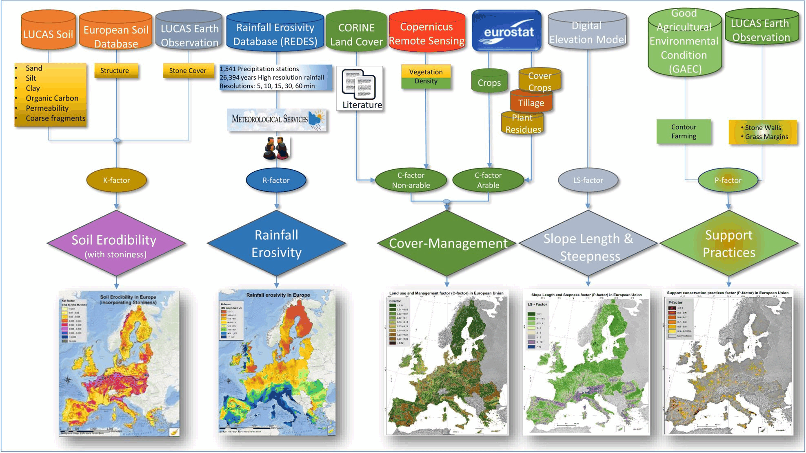
RULSE: A = R * K * LS * C * P

Slide 5
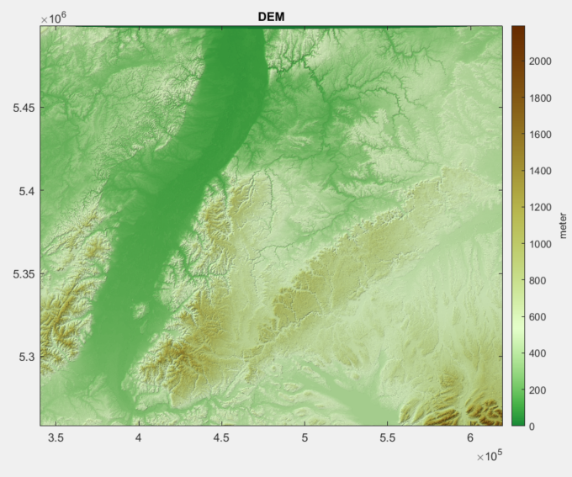
What areas do you expect most erosion?

Slide 6
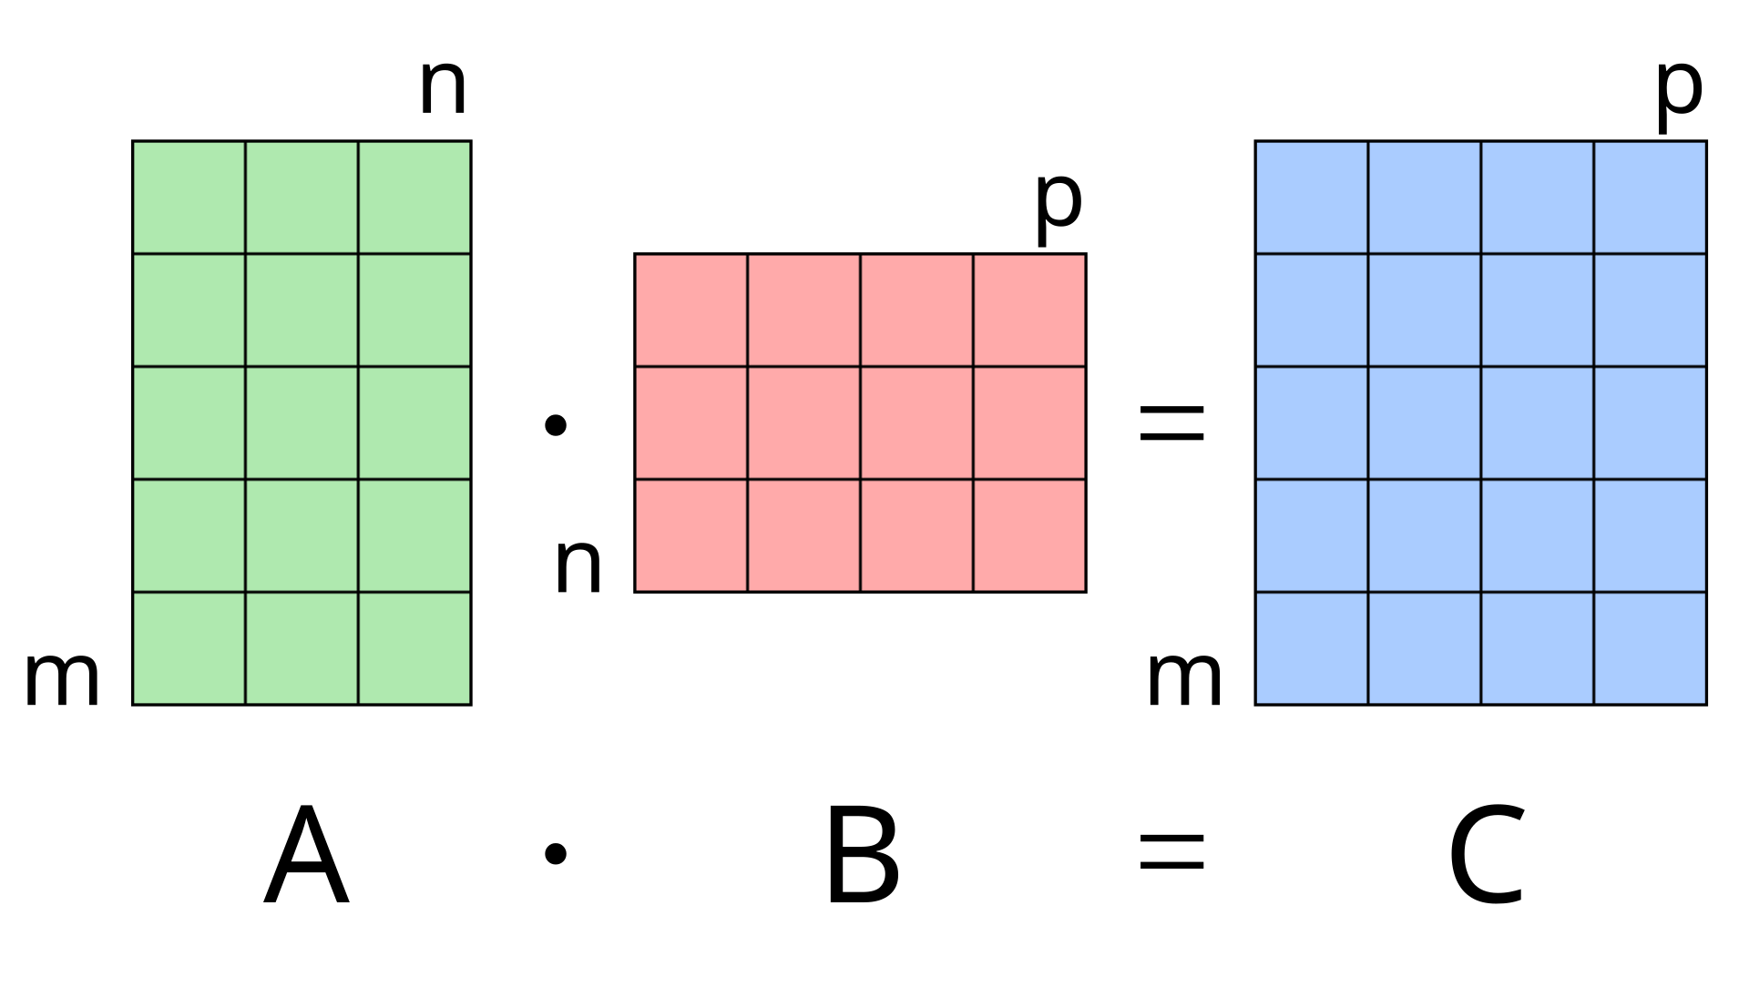
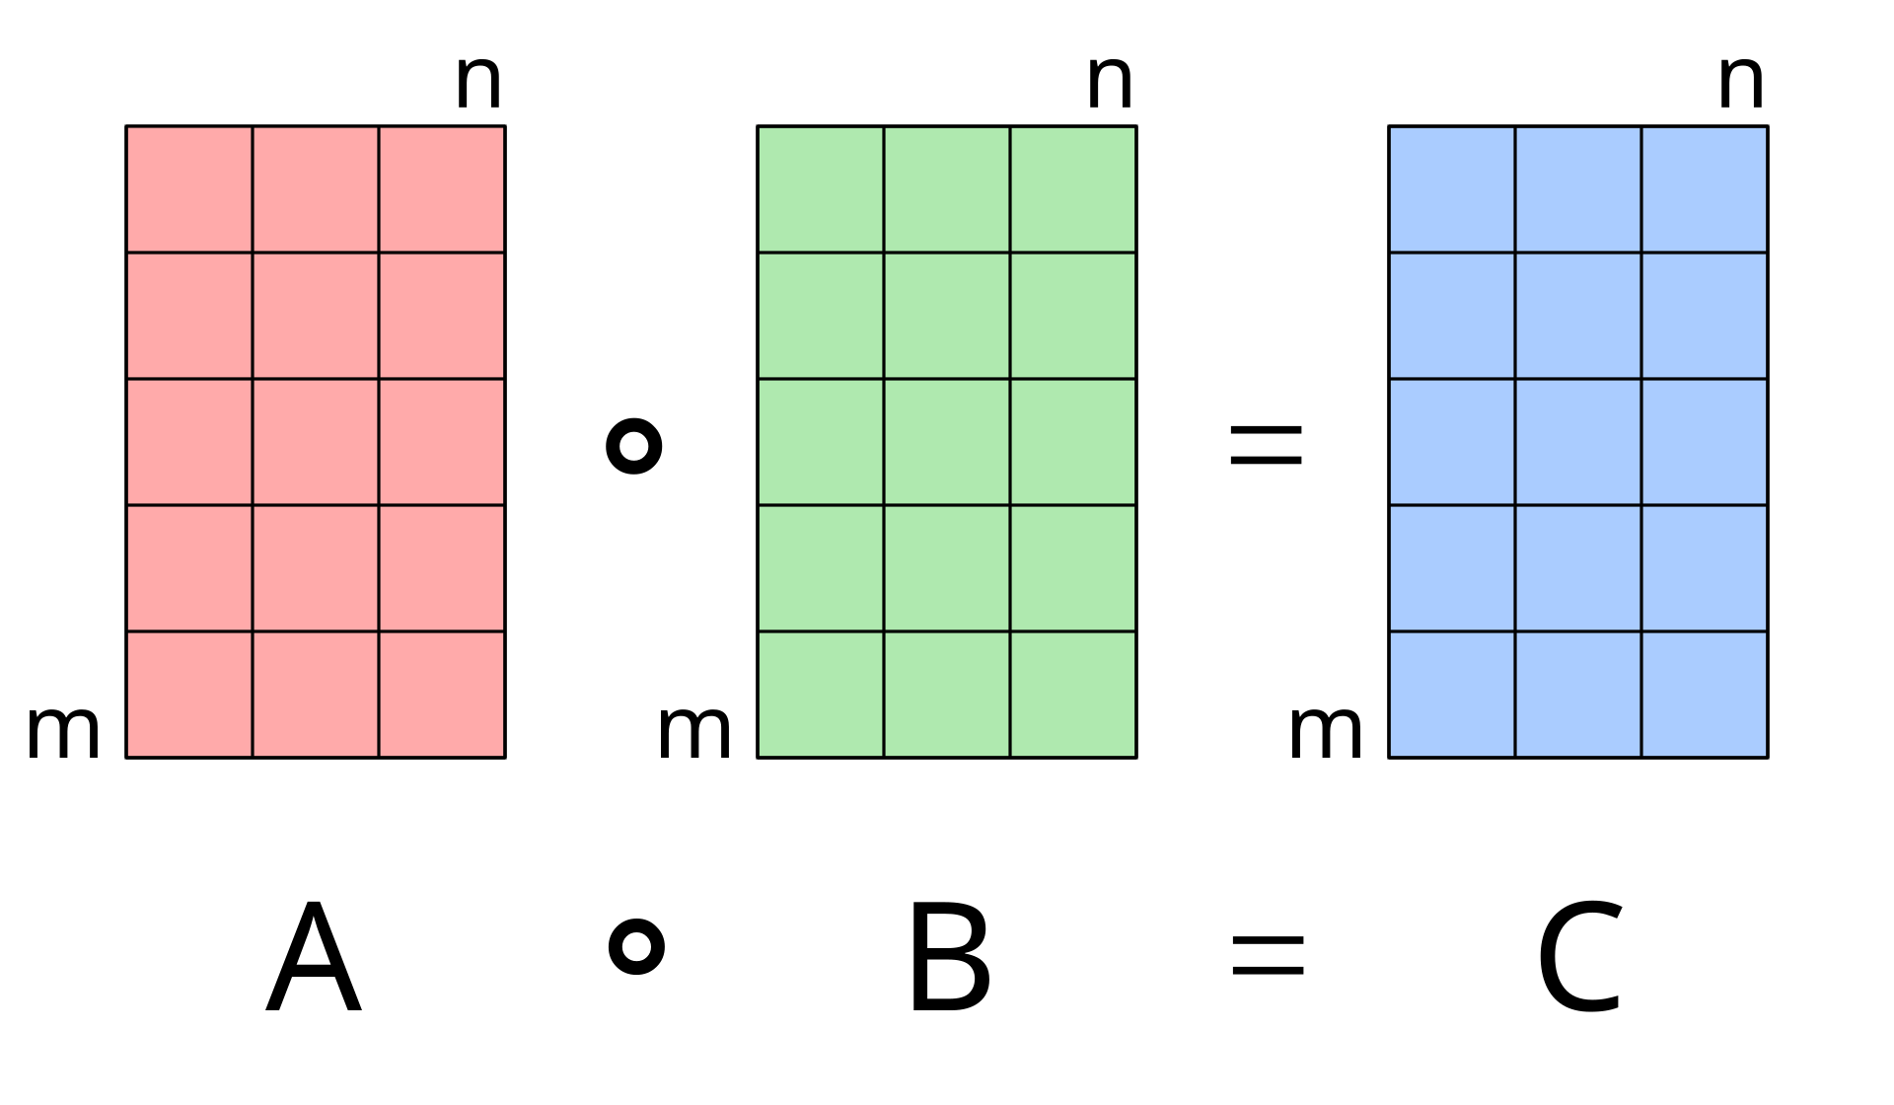
Matrix multiplication
normal
Element wise (raster times raster)

Slide 7
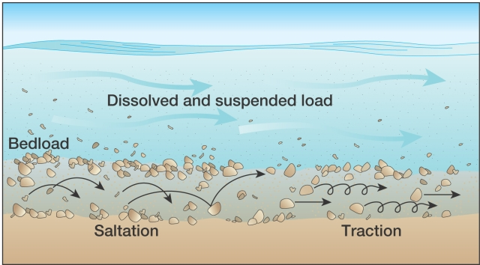

Slide 8
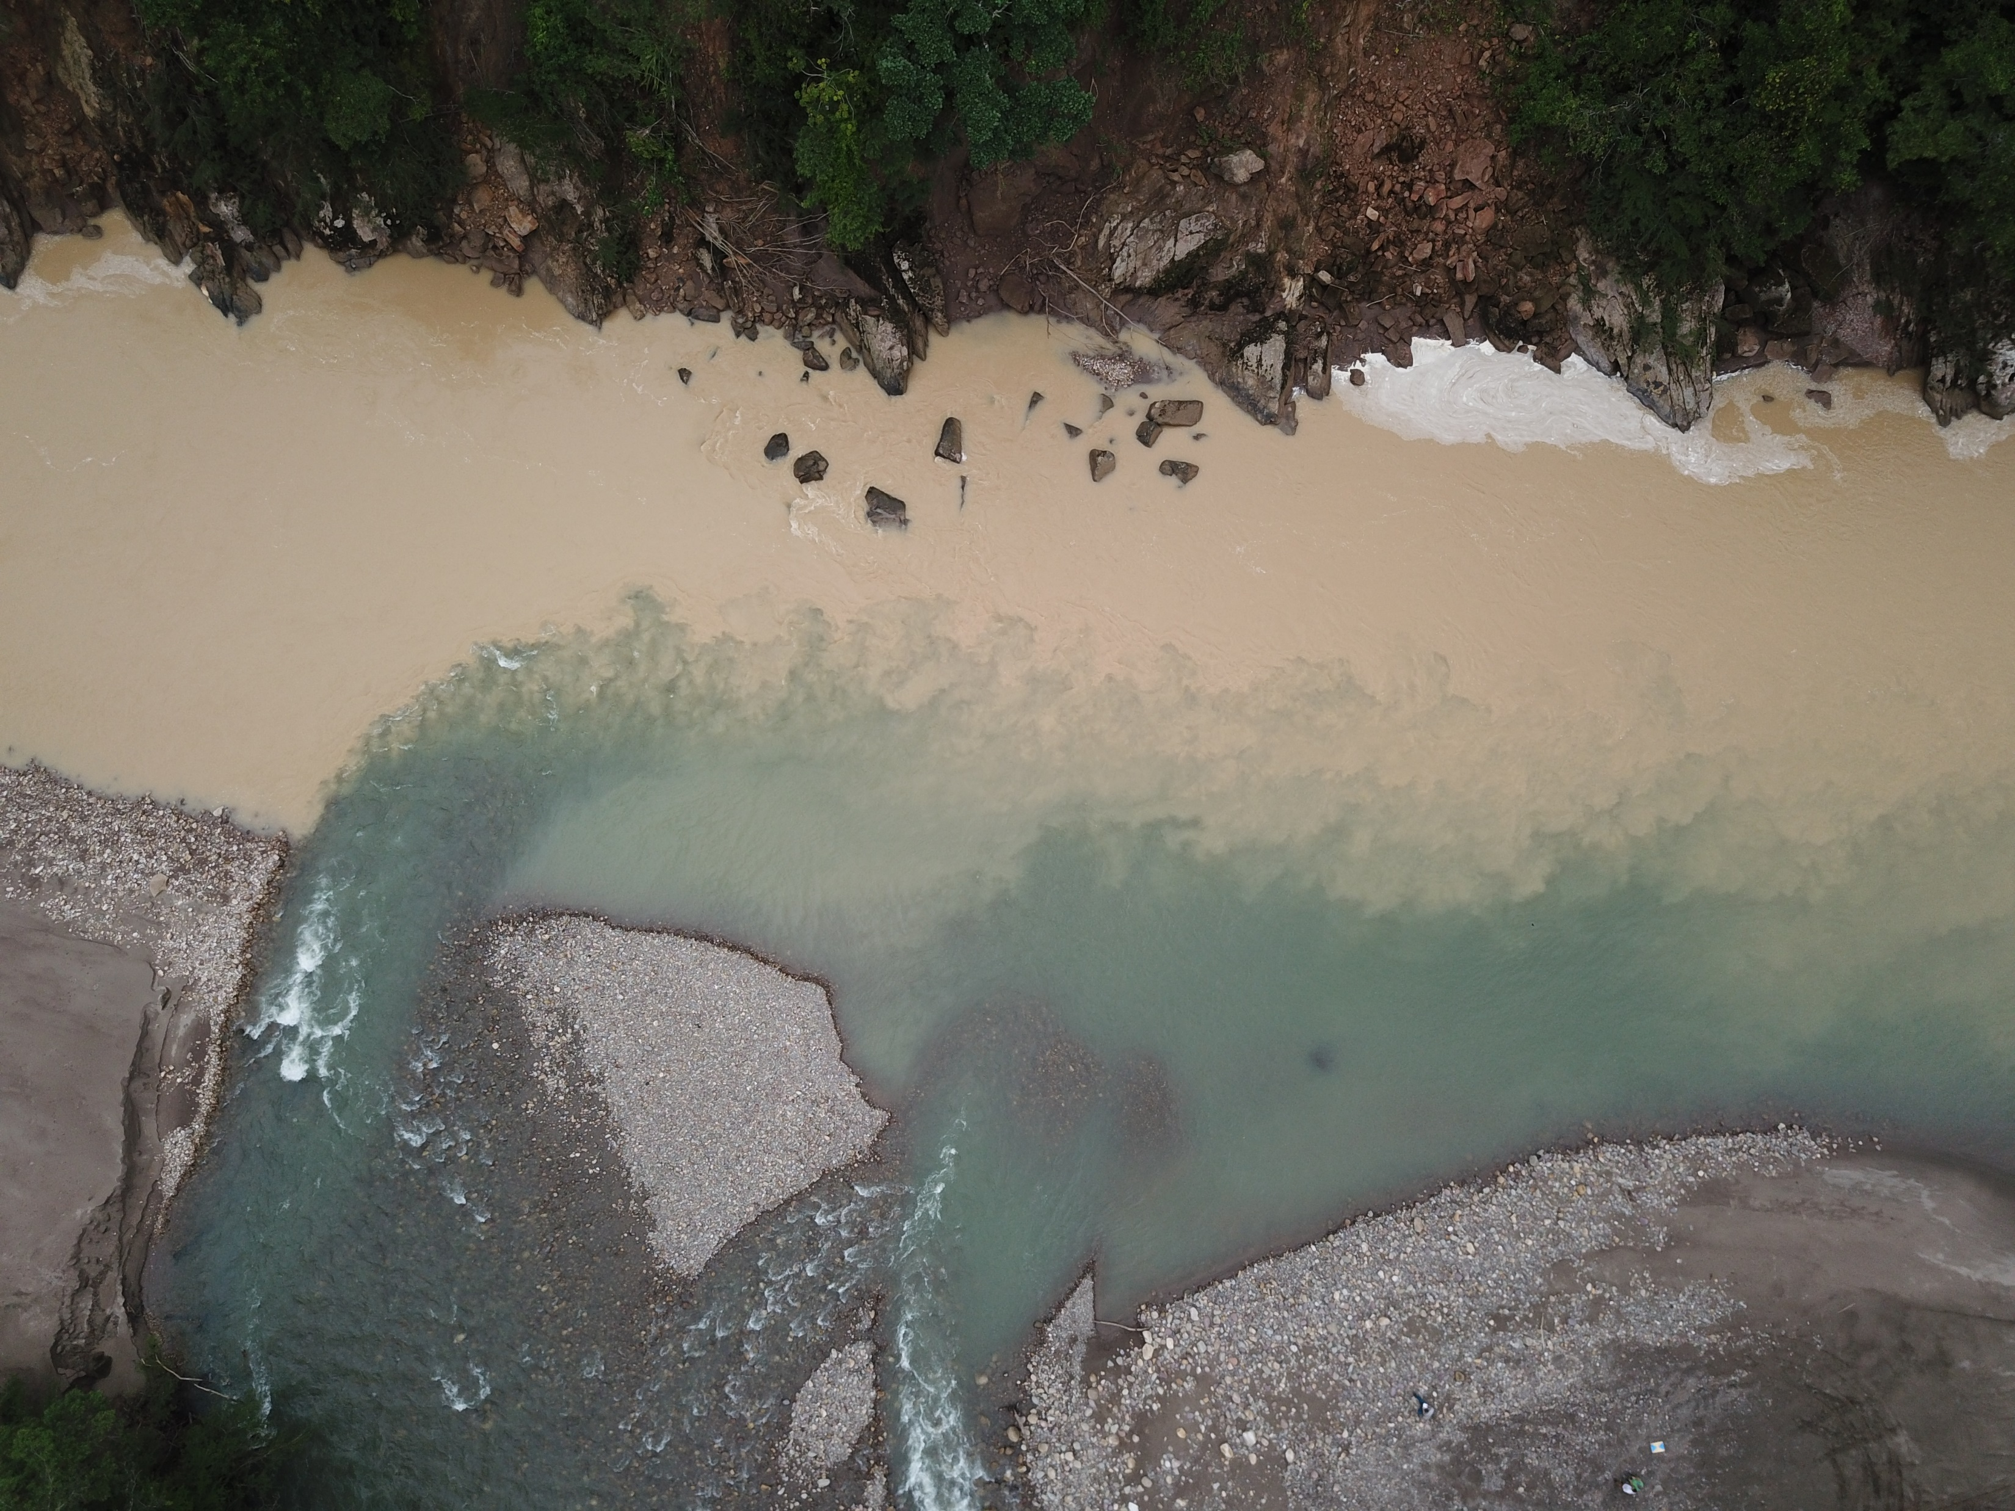
Differences in suspended sediment loads of rivers in Colombia

Slide 9
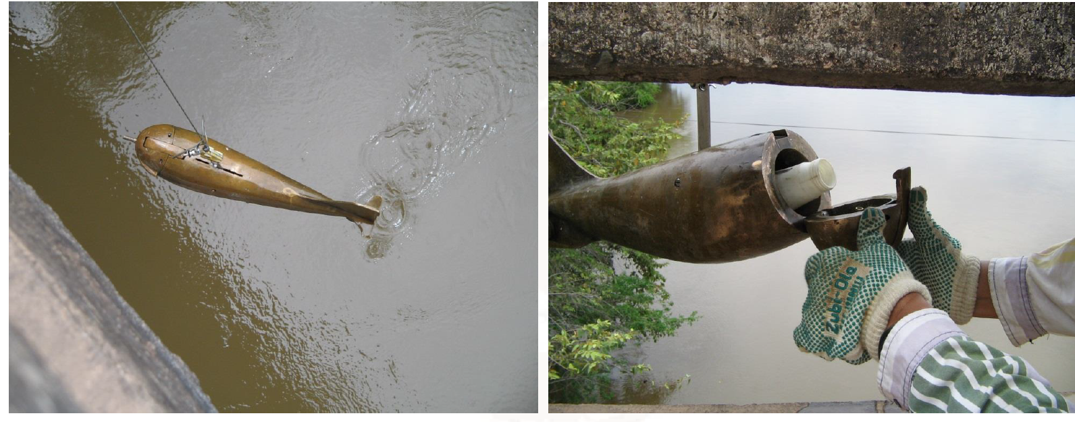
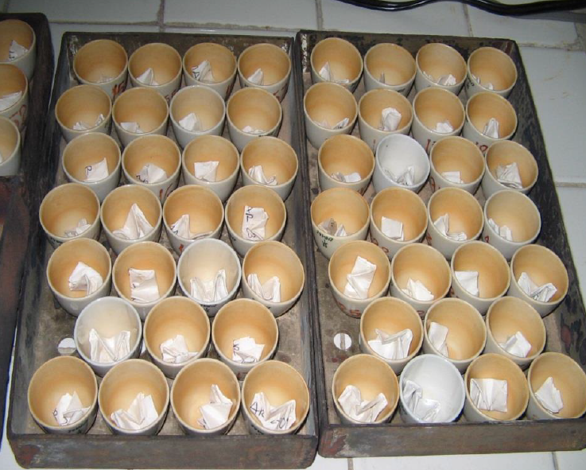
Suspended sediment samling

Slide 10
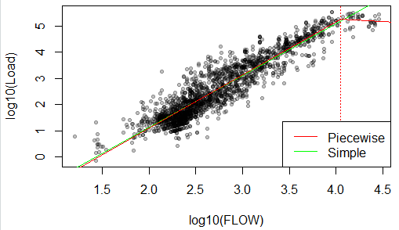
Sediment rating curve to estimate sediment discharge

